Slide 1
Developing Key Contacts for Bigger Giving
From One Drop of Water Mighty Rivers Flow
Understanding, Identifying, Cultivating, and Securing Investors for Your Organization
David Condon
Chief Executive Officer Diversified Nonprofit Services, LLC

Slide 2
2015 charitable giving Total = $373.25 billion This is an increase of 4% from 2014.

Slide 3
Types of recipients of contributions, 2015 Total = $373.25 billion

Slide 4
Fundraising: The Changing Environment
Using a New Vocabulary:
Words to Eliminate:
Contribution
Donation
Donor Base
Charity
Need
Volunteer
Nonprofit Management
Passive
Reactive
Words to Embrace:
Investment
Stock (ROI)
Market Share
Business
Achieve
Partner
Business Management
Aggressive
Proactive

Slide 5
There Are Fundamentally Two Types of Organizations:
Proactive
Reactive
Embraces Change
Aggressively Seeks Opportunities
Sees Change As An Opportunity for Growth
Moved to Action
Outcomes Drive Resource Development Plan
Assesses, Plans, Secures Resources, Implements, and Evaluates
Resists Change
Strives to Maintain a Level of Comfort
Sees Change As An Obstacle to Success
Frozen In Fear
Available Resources Limit Outcomes
Struggles to Secure Resources To Maintain Current Level of Service

Slide 6
Proactive vs. Reactive Continued
Proactive
Reactive
Focus On Fixing What Has Already Happened
Accepts Mediocrity Through Complacency
Settles for Current Programs Disregarding New Community Needs
Survives At the Mercy of It’s Funders
It’s Fear Is Focused Anxiety That Paralyzes The Mind, Body, and Spirit and Immobilizes the Organization
Focus Is On What Needs To Be Done
Challenges It’s Board and Staff To Excel
Strives to Meet the Emerging Needs of a Changing Community
Controls It’s Own Destiny
Takes Action Which Creates A Feeling Of Freedom And Puts The Organization In Control.

Slide 7
The Dawn of the Social Entrepreneur
Social entrepreneurs are individuals who approach a social problem with entrepreneurial spirit and business acumen.
Business entrepreneurs create businesses, social entrepreneurs create change.

Slide 8
Watch Out What You Ask For!
Why Target A Specific Amount?
If you ask for a donation you’ll get one.
But it won’t be large enough to make your goal and impact your organization.
Targeting a specific amount based on qualified research provides the Investor with a frame of reference to an Investment level they are capable of and which will help you make your goal.

Slide 9
A Investment Is Only The Beginning
Organizations must take an ongoing approach to fundraising through active cultivation and stewardship
You should not view a successful solicitation as an end point, but rather as the beginning of a new relationship
It’s the responsibility of the agency staff and Board to build relationships and solicit donations
Once you secure a Contribution you want to Increase it each year through an effective Stewardship Program
Notes:
Organizations that are generally successful in fundraising take the farming approach!

Slide 10
The Process: It is a simple Circle of Effort
Cultivation
Solicitation
Stewardship
Identification of
Potential Friends

Slide 11
Cultivation and Stewardship
What is cultivation and stewardship?
How is it executed?
Why is it important?
You don’t win the race until you get a gift every year from the same donors

Slide 12
Cultivation Defined
_{Relationship}
_{Relationship}
_{Relationship}
_{Cultivation}

Slide 13
What is cultivation?
It is all the relationship building steps that lead to a tangible association with your organization
Through cultivation, you learn more about investors, and they learn more about you
A relationship is formed!

Slide 14
investor Cultivation
Cultivation makes the solicitation possible…done well, it sets the stage for a successful “ask”
Cultivation is not random; it is deliberate and strategic
Cultivation should involve board volunteers
Cultivation continues as part of a stewardship program once Investments are made

Slide 15
Cultivation Strategies
Organizational Tour / Open House
Include a touchable moment
Something that occurs during the tour or open house to connect the investor to your clients and the mission of your organization
This is planned and not left to chance!!
Have your clients lead the tour
Testimonial / personal story
Small House Parties
Small intimate gatherings hosted by a volunteer
No more than a 10-15 minute formal presentation
This is NOT a solicitation event.
Make this clear in the invitation
Notes:
Presentation should include
Testimony from host (why are they involved in your organization)
Organizational Facts presented from staff
Attention Getter- testimony of how your organization has had an impact
A video or PowerPoint presentation
That engages people emotionally

Slide 16
Cultivation Strategies
Show & Tell Events
Take your show on the road
How can you bring your mission to the community?
Have your clients make part of the presentation if possible
Testimonial / personal story
Volunteer Opportunities
Volunteer opportunities give individuals ownership of your organization
Seek opportunities to help match volunteers to their area of interest
Look for opportunities to get people involved
Ask for help with specific task.

Slide 17
Volunteer Opportunities
Example
One nonprofit used a community build model to construct a new play ground. Over 170 volunteers participated in the build which was held on one day and completed in a six hour time frame.
Notes:
As a result of enlisting the support of volunteers the Club received the following benefits:
increased financial support
contact information on potential investors and volunteers
a new base of volunteers
increased public awareness
There are now 170 people who feel some ownership and a tangible connection to the Brigade Boys & Girls Club.
While, it would have been easier to pay a construction firm a small fee to build the playground; using the community build model and recruiting the help of volunteers has reaped many benefits for this agency.

Slide 18
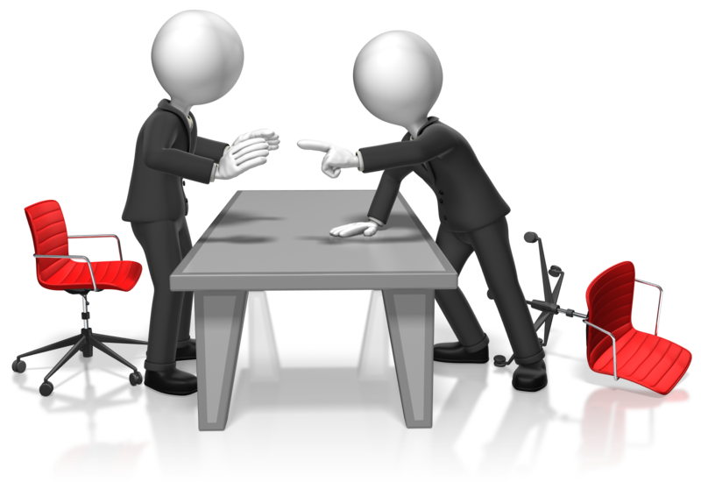
Cultivation Strategies
Advice Visits
Based on the adage “If you want advice ask someone for money”, if you want money ask someone for advice
An advice visit is a time to seek someone’s opinion and guidance about a particular project or program
An advice visit can open many doors and is a great way to engage reluctant board members
Most people feel complimented that you would seek their advice and counsel

Slide 19
Cultivation Strategies
Advice Visits - Tips for the visit
Ask for a short appointment - 30 minutes
Listen. Make sure the person you are visiting does the majority of the talking
Do not try to “sell” anything
Be interesting. Rehearse what you are going to say. Have questions prepared
Follow-up and keep the person informed of progress
Notes:
What do you think about this project / program?
Do you think it is a need?
What part do you find the most interesting?
How do you think we should go about getting more support?

Slide 20
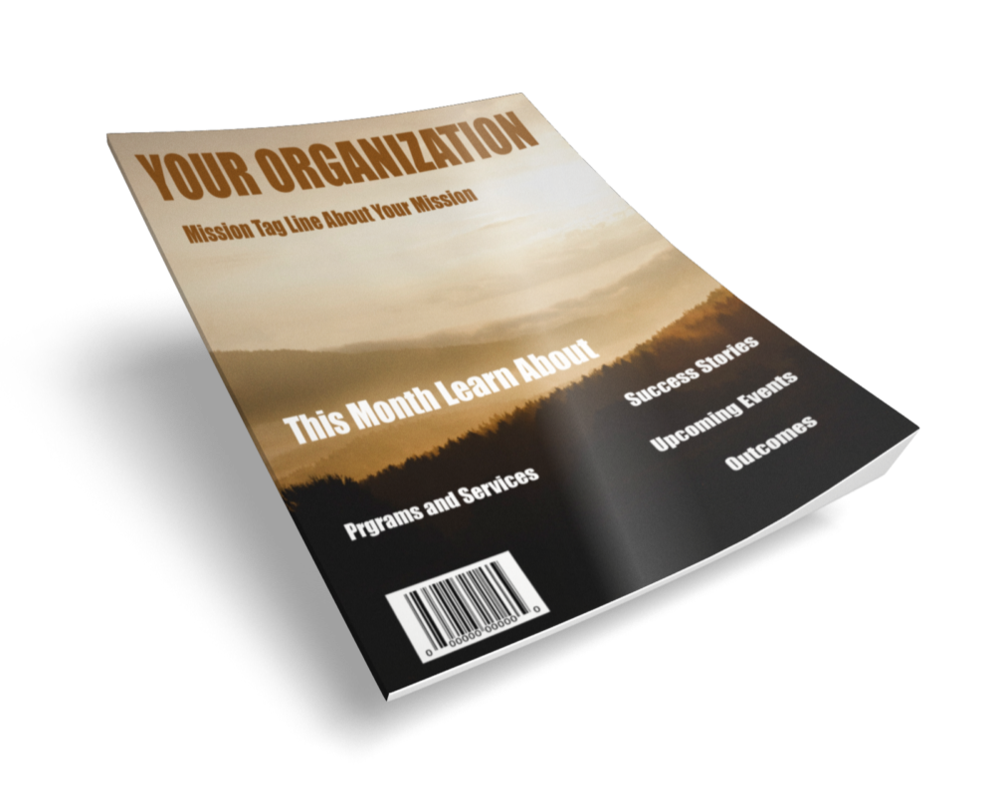
Other Cultivation Strategies
Newsletter
Ensure it communicates your impact
Highlight the clients you serve
Ensure it is balanced
Distribute by email
Mailings / Hand Written Notes
Press Releases
Speaking Engagements (civic clubs, fraternal organizations, etc.)
Invite civic clubs to hold one of their meetings at your location

Slide 21
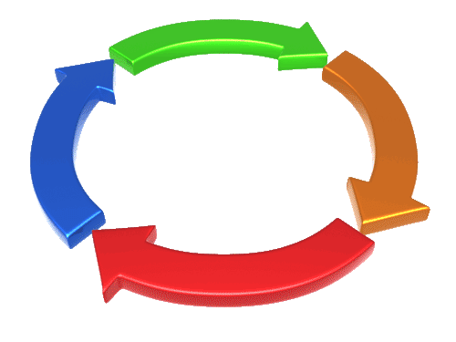
Cultivation is a process
Not an event or even a series of events
It is a process of developing meaningful relationships
Cultivation is pointless without a follow up plan
Cultivation enables you to help investors reach their goals through participation with your organization!
Notes:
Develop a plan: Who? How? When? Why?
Capture contact information at events
Find out areas of interest
Call and thank for attending/participating
Get feedback

Slide 22
Stewardship Defined
It’s more than a thank you note!

Slide 23
What is Stewardship?
Stewardship involves using Investments in the manner in which they were intended, reporting to investors on the use of their Investments, then thanking, informing, and involving investors in your organization
Stewardship is designed to assure the investor they made a good decision in the giving to your organization and to motivate them to continue with their support

Slide 24
What do we owe our supporters?

Slide 25
Investor Bill of Rights
Philanthropy is based on voluntary action for the common good
It is a tradition of giving and sharing that is primary to the quality of life
The investor Bill of Rights ensures that:
Philanthropy merits the respect and trust of the general public
investors and prospective investors can have full confidence in the nonprofit organizations and causes they are asked to support
The Investor Bill of Rights was created by the Association of Fundraising Professionals (AFP), the Association for Healthcare Philanthropy (AHP), the Council for Advancement and Support of Education (CASE), and the Giving Institute: Leading Consultants to Non-Profits

Slide 26
Investor Bill of Rights
Clarity about organization's mission and how it will use donations
Board that applies prudent judgment and stewardship
Financial and operational transparency

Slide 27
Investor Bill of Rights
Investments acknowledgement and recognition
Privacy / confidentiality
Relationship with the organization handled professionally

Slide 28
Stewardship Strategies
Investment acknowledgement within 48 hours
Personal visits
Formal investor recognition
Annual reports
Newsletters and program brochures
Personal letters
From Board; executive; one of your clients
Telephone calls
Personalized birthday greeting
Receptions

Slide 29
Stewardship should not be left to chance, but should be part of a structured plan!

Slide 30
Sample Stewardship Calendar
 | JAN | FEB | MAR | APR | MAY | JUN | JUL | AUG | SEP | OCT | NOV | DEC
Quarterly Newsletter
Valentine’s Day Cards
Summer Information Luncheons
Christmas Caroling
Thank you calls (Board Members)
Open House/ Appreciation Event
Select One Special Week to Celebrate

Slide 31
Relationships Are Personal

Slide 32
Make It Personal
Personal contact is key
Shows the importance of the relationship
Shows respect for the investor
Carries the credibility of the person representing the organization (Board member, staff, etc.)
Enables a dialog to precede the ask

Slide 33
_{Why?}

Slide 34
Friendraising
_{Cultivation}
_{Stewardship}
_{Friendraising}

Slide 35
Developing Friends
Why develop Friends rather than investors?
Friends support you through the difficult times
Friends give meaningful and sacrificial Investments
Friends tell their friends about you
Friends ask their friends to help
Friends provide advice and feedback
It is difficult to lose a friend

Slide 36
Investor Pyramid
Planned Investments
Capital Investments
Major Investments
Annual Investments
Special Events
Cultivation & Stewardship lead to major, capital & planned Investments. Friends provide for your organization on a long term basis

Slide 37
The Process: it’s Still Simple
Cultivation
Solicitation
Stewardship
Identification of
Potential Friends

Slide 38
Make a Plan
Task | Person Responsible | Date
Identify prospects | Board members Staff
Evaluate giving potential of each prospect | Board members Executive Director Resource Development Director

Slide 39
Process vs. Reason
Don’t Forget The Reason Why You Exist

Slide 40
Remember that drop of Water

Slide 41
Thank You!

